Slide 1
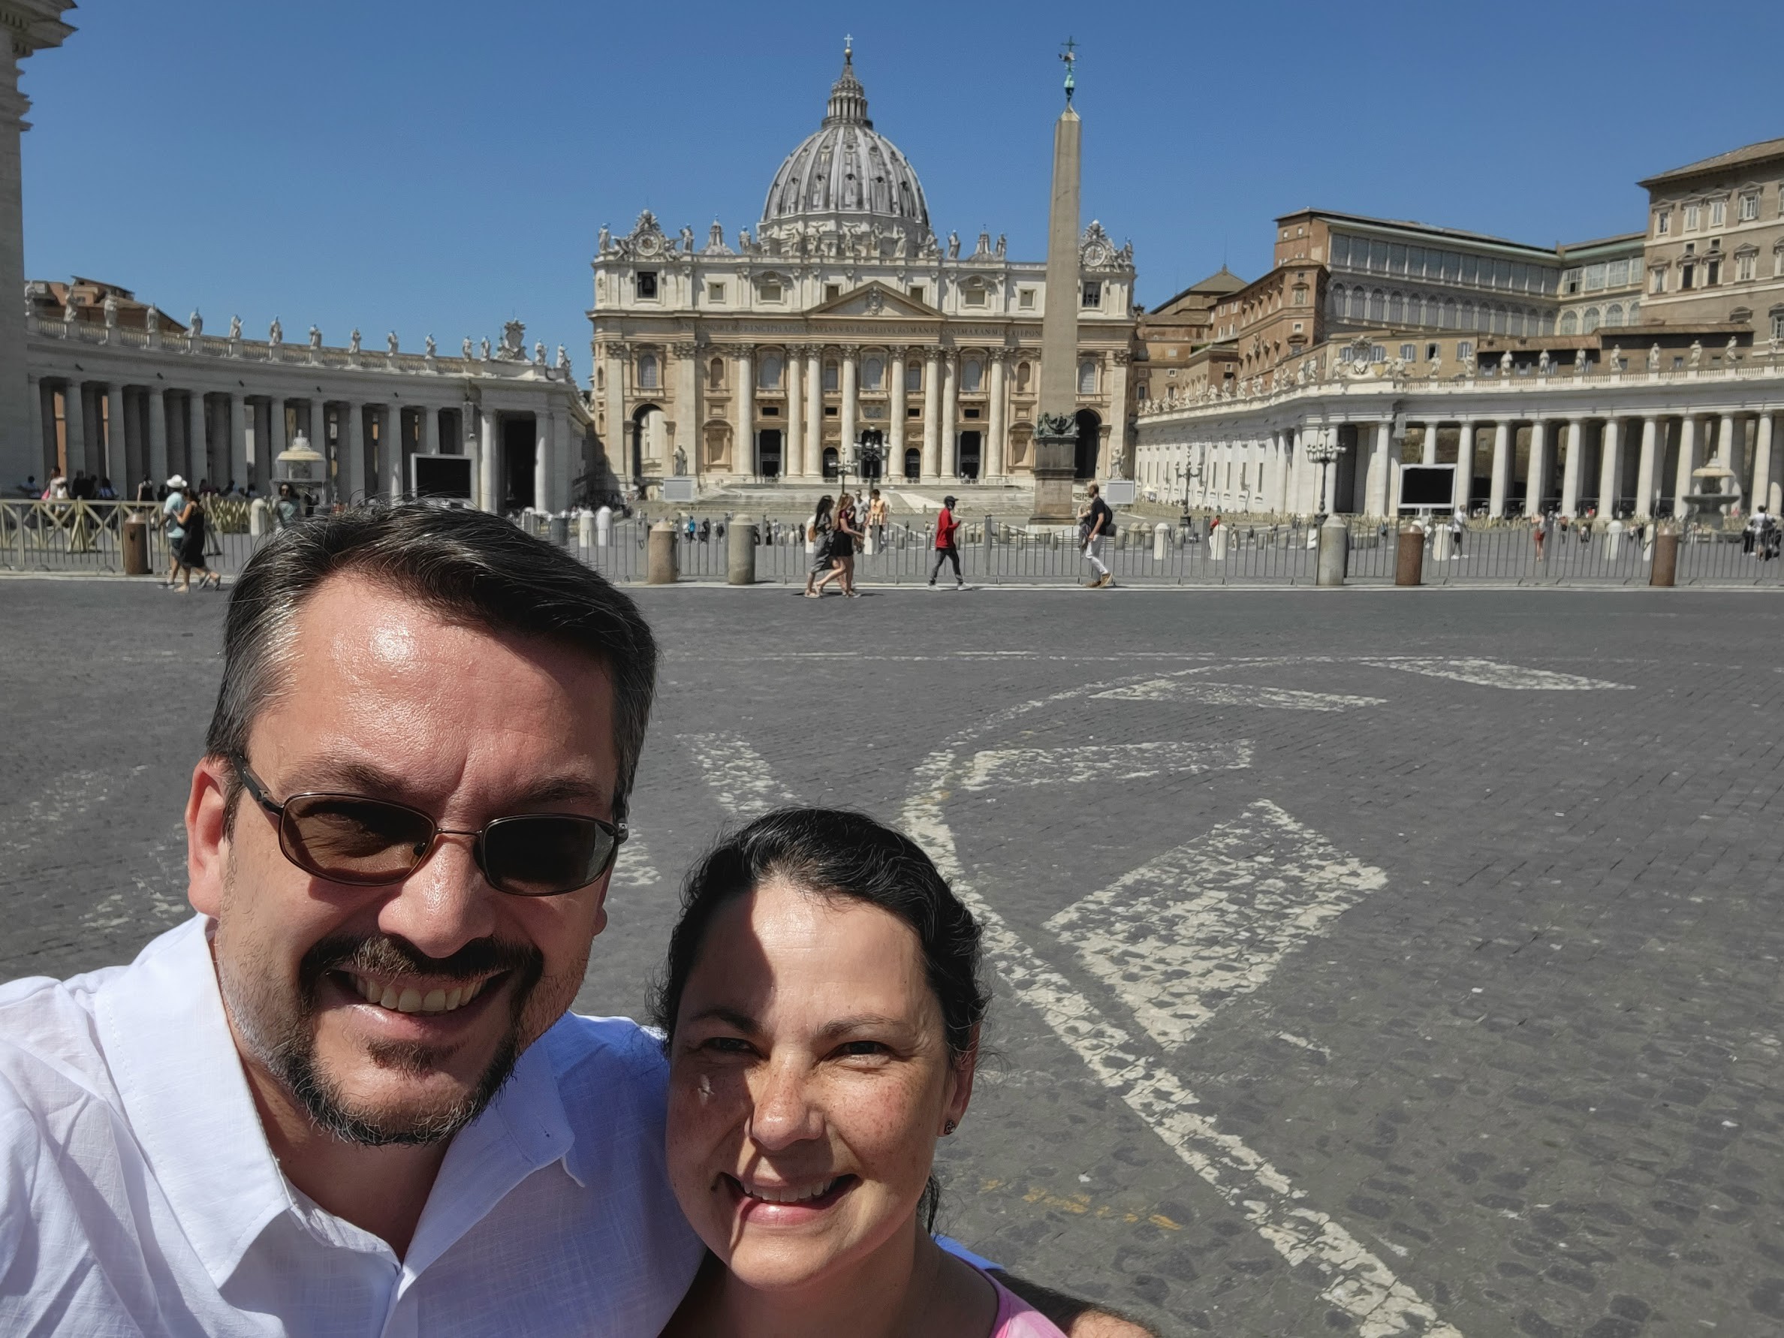
Victor Danilchenko
The Man
The Myth
The Slightly Less-than-myth-like Reality

Slide 2
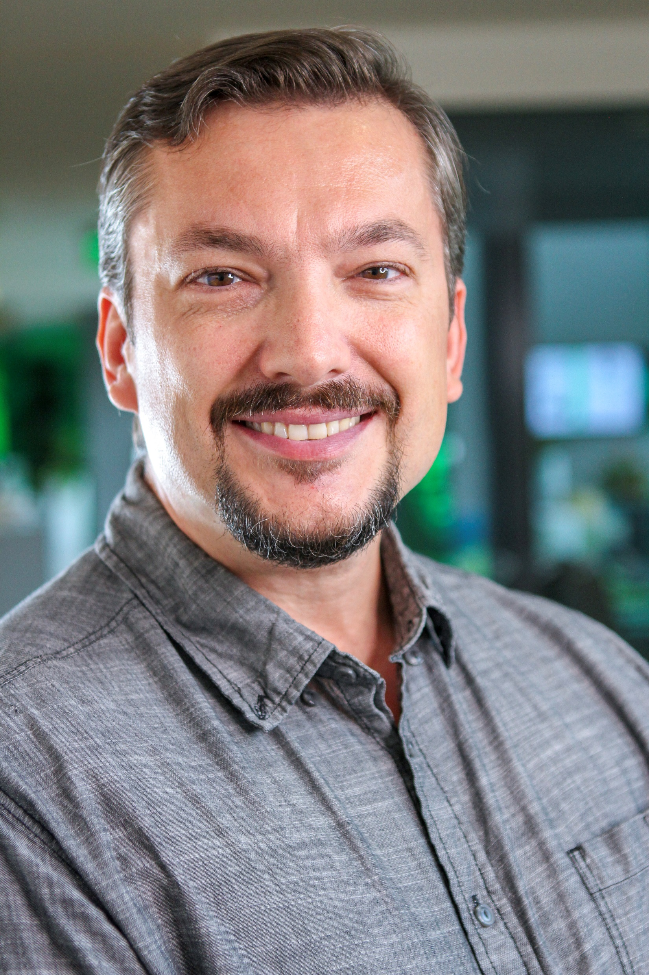
Introductions
Born & raised in USSR (Kyiv, Ukraine)
1 year in Israel
30 years in USA
5 in New York City
25 in Massachusetts
IoT leader & architect
MS in CS from UMass/Amherst

Slide 3
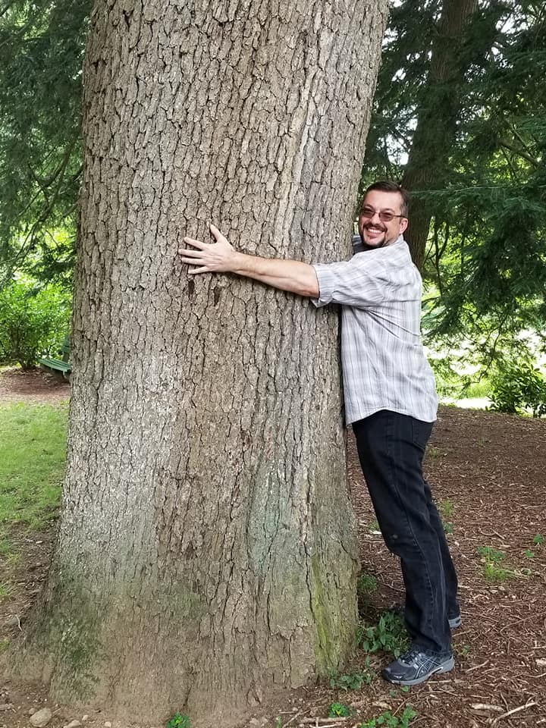
Introductions
tree hugger
steak aficionado
polyglot
amateur
philosopher

Slide 4
Life stages

Slide 5
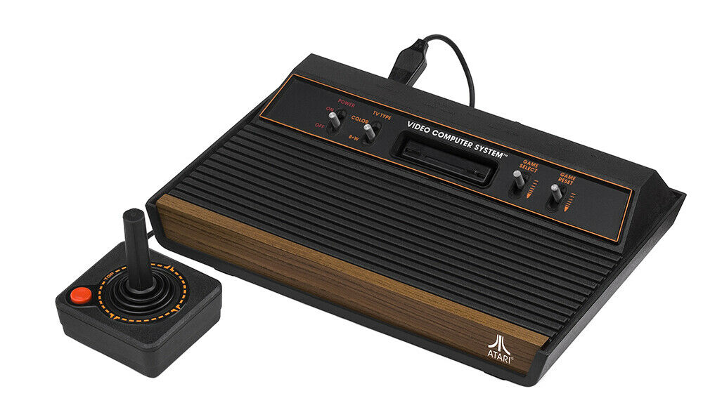
Life stages: USSR (1974-90)
Future computer scientist
Love at first sight! (at 13)
Studied programming in highschool
Science competitions
Hiking & orienteering
Winning competitions in cartography and azimuth
Lived through Chernobyl
80km downwind from the plant
Evacuated south

Slide 6
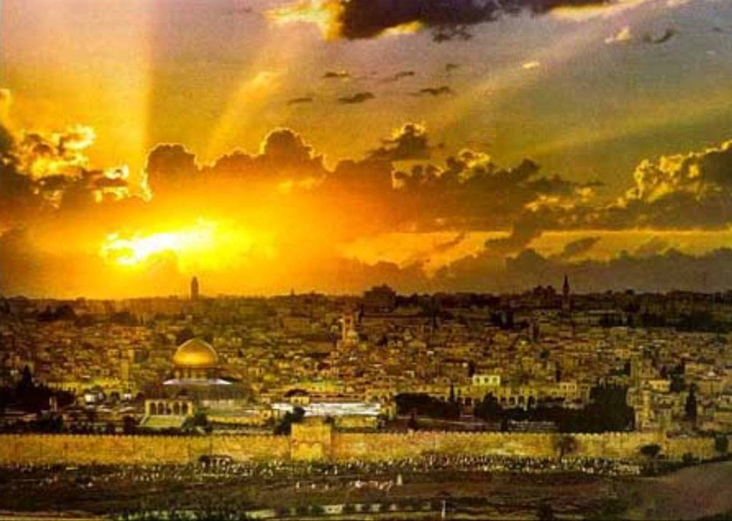
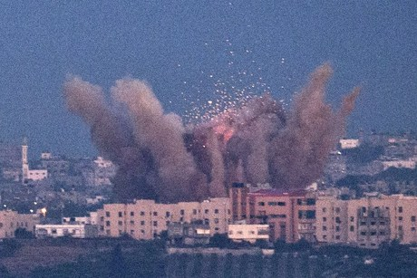
Life stages: Israel (1990-91)
Future computer scientist
Specialized Computer Science highschool
Left USSR behind --
Free world awaits!
Gulf War 1
SCUD missile bombardments
Hiding in bomb shelters every day for months
Crazy gas-mask hair!
Left Israel for safety concerns

Slide 7
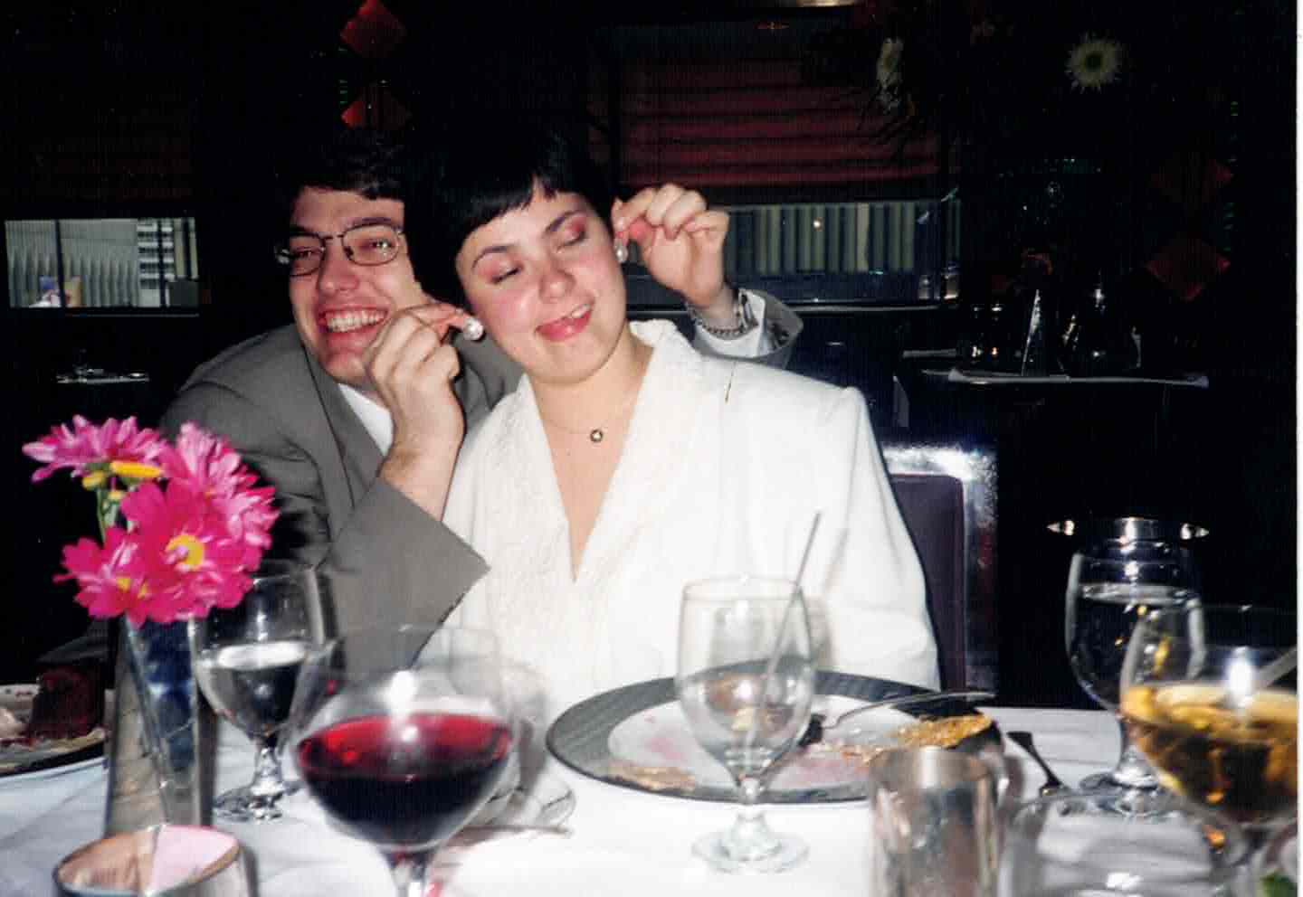
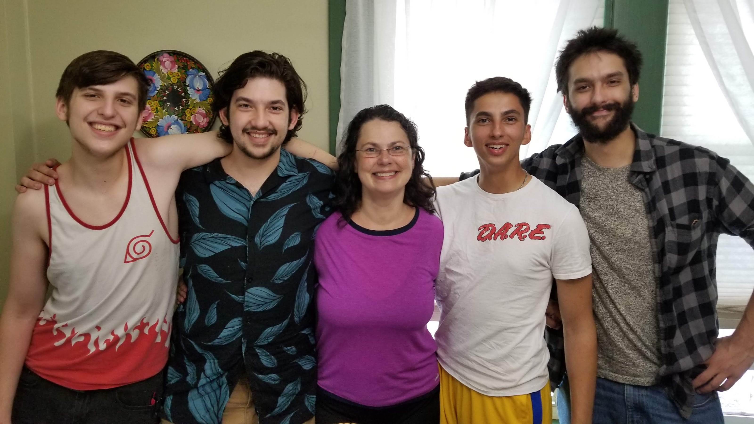
Life stages: USA, NYC (1991-96)
Actual computer scientist
BS in CS
Math & Philosophy minors
First industry job (programmer, at 20)
Accepted to grad school at UMass
Got married at 22
Love of my life
25 years later and 4 kids later…

Slide 8
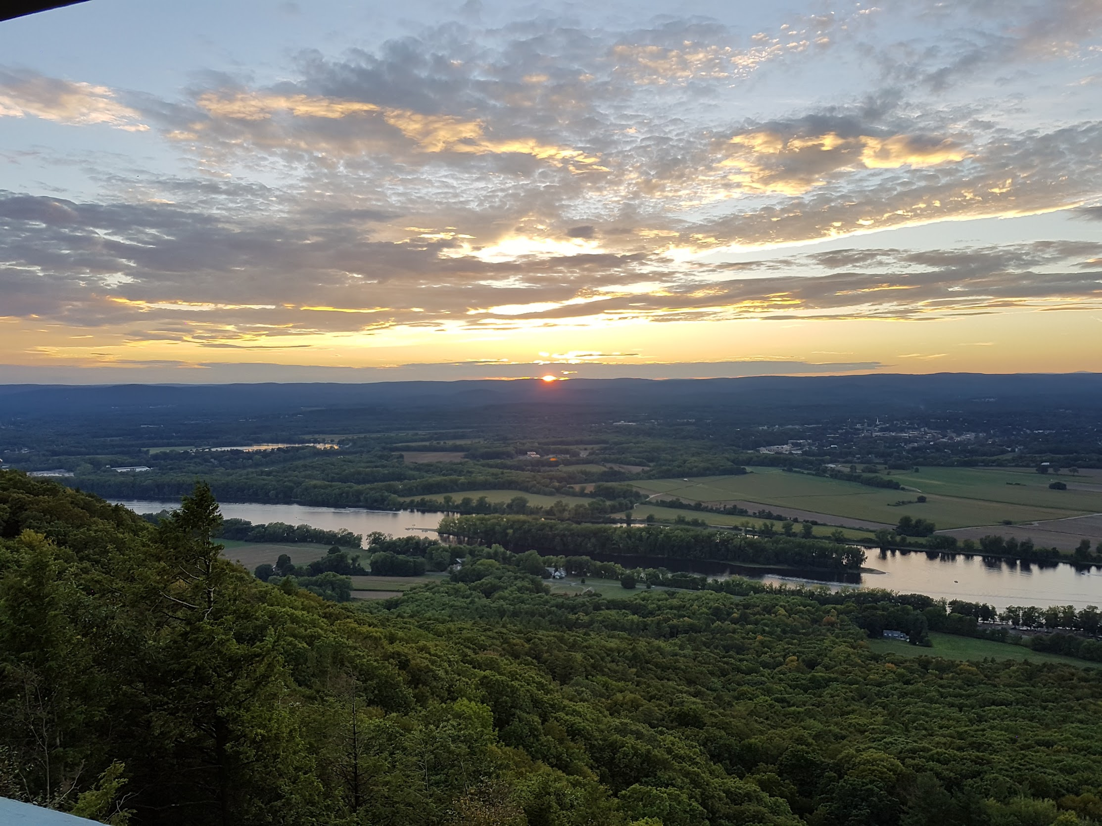
Life stages: USA, Massachusetts (1996-present)
Grad school
Earned MS
AI concentration
Industry work
A fulfilling tech career
Pioneer Valley
One of the beautiful places of the world
Hiking galore!
Almost empty nesters

Slide 9
Career phases

Slide 10
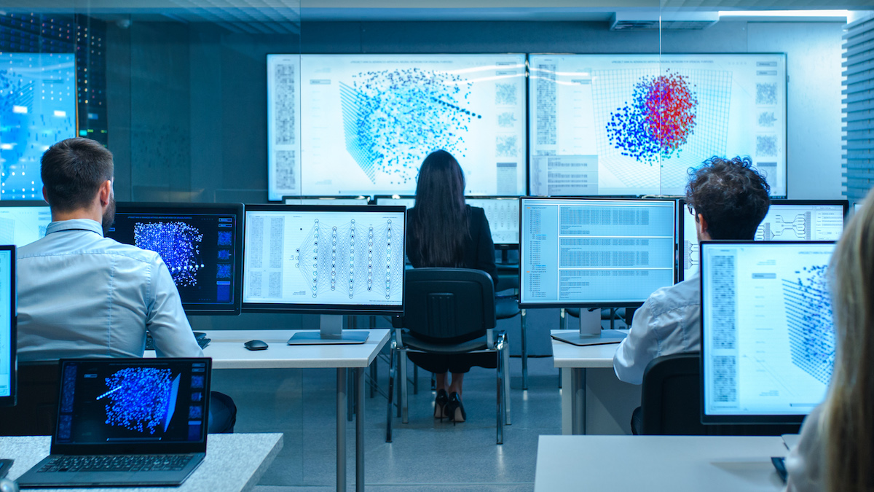
Career phases: Grad school & UMass
AI research
Resource-Bounded Reasoning lab
Two published articles
Research is not for me…
(I like making useful things)
Worked at CompSci department as developer & sysadmin

Slide 11

Career phases: AskOnline
Small educational startup
Sr engineer, then CTO
SaaS solution
Full-stack "plus"…
Sales engineering
End-line support

Slide 12

Career phases: Cimpress
Solution architect
Knowledge Management group
Largest private MediaWiki in the world!
Built microservice platform
DevOpsed infrastructure mgmt.
Automated a variety of team services & resources

Slide 13

Career phases: Schneider (present day)
Principal IoT solution architect
ProServ team
TOGAF certified
38 customer projects
Patents, papers…
Chief architect on select projects
Launched multiple initiatives

Slide 14
Portfolio highlights

Slide 15
Portfolio: Reference Architecture Framework (RAF)
Existing references (Amazon, Google, Microsoft) didn’t meet our needs
Needed to address end-to-end evolution
Including non-functional concerns (security, regulatory compliance, operationalization, etc.)

Slide 16
Portfolio: Reference Architecture, cont.
Metamodel: Heart of the Framework
Capabilities (functional)
Connectivity
Data processing
Business integration
Etc.
Concretized by patterns
Considerations (non-functional)
Security & Privacy
Regulatory compliance
Operationalization
Digital supply chain
Etc.
Adopted by our IoT platform for customer communications

Slide 17
Portfolio: Bootcamp
Class we teach about IoT
Based on RAF Metamodel
A 3-day traveling event
(not much traveling now)
Modular
Adaptable
Manager: “Best diagram I’ve ever seen!”

Slide 18

Portfolio: Intellectual property
9 patent applications across multiple domains
(I am first inventor on all of them):
Architecture
Security
Data science
Two published papers:
Data science (Ontology)
IoT Security Architecture

Slide 19
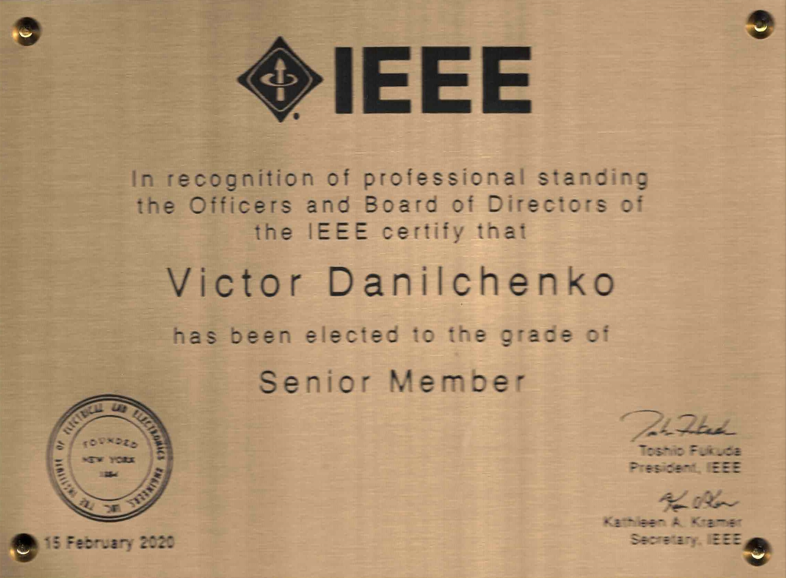
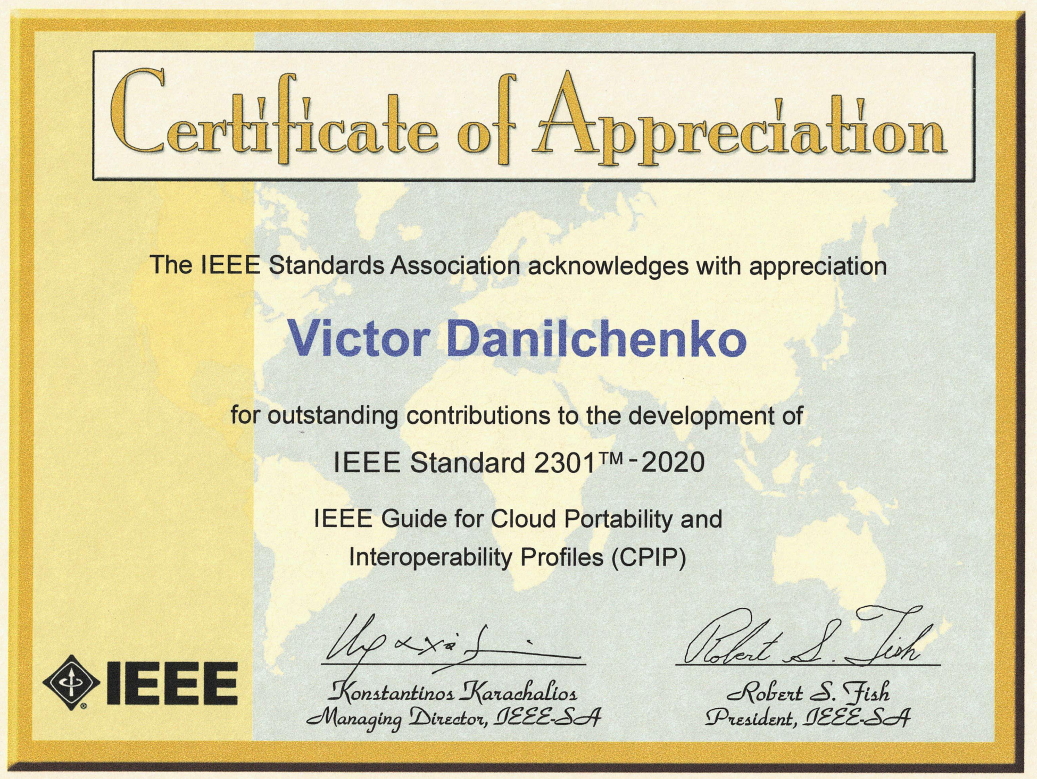
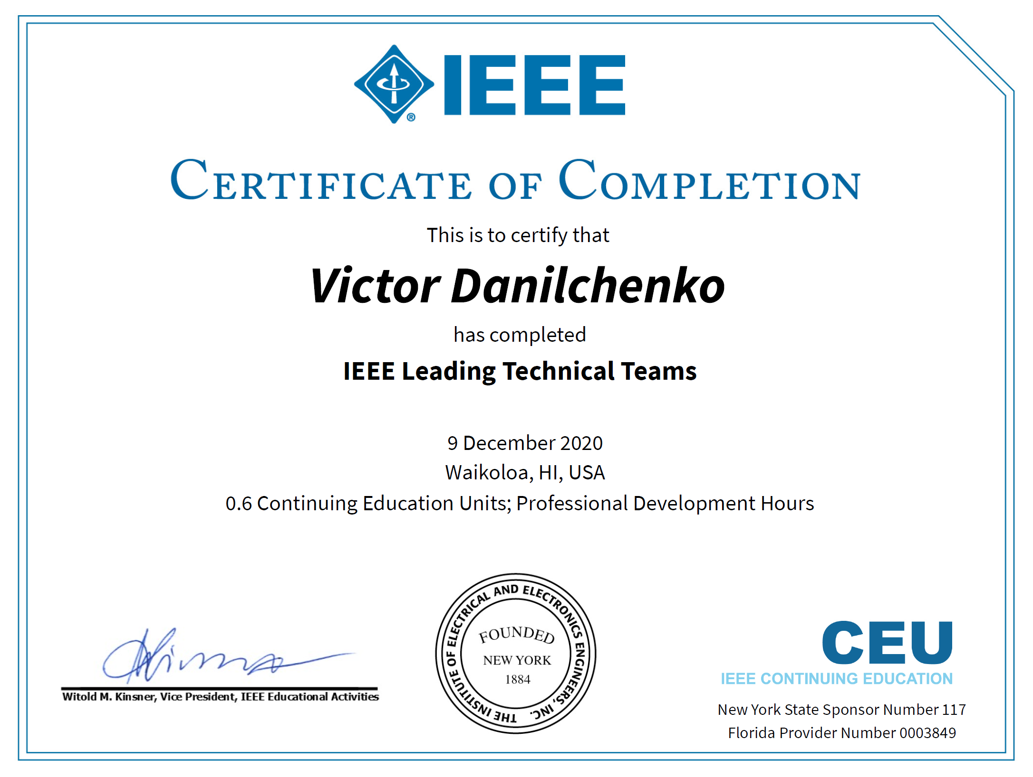
Portfolio: IEEE & Standards work
IEEE Senior member
Standards bodies participation:
IEEE 2301-2020
Cloud Portability & Profiles
IEEE P2302 draft
Intercloud Interoperability & Federation
NIST 500-322
Cloud Federation Reference Architecture
Taught an IoT seminar at IEEE
Technical Team Leader cert

Slide 20
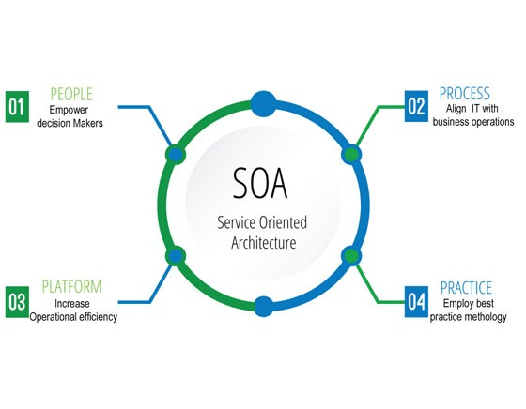
Portfolio: Technical platform work
Not my day job
(I get paid to work with customers)
BUT… I gotta make things better! (Boyscout rule)
Architected three platform components
LPWAN bridge
SigFox integration service
Data processing pipeline
Personally built one of them
SigFox integration service

Slide 21
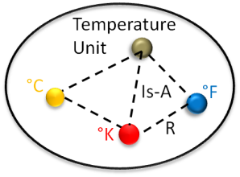
Portfolio: Ontology initiative
Abstract
Functions
Software
Config.
Protocols
Identified a key need
Drove initiative from ideation to delivery
Organized ad-hoc team
Co-wrote a paper
Filed several patent apps
Presented the case to mgmt.
Group created
Secured incremental funding
Common Ontologies
Units
Location
Entities
Physical
Quantities
Grey Area
Smart
Grid
Data
Centers
MMM
Buildings
Specific Ontologies
Transportation
Power

Slide 22
Conclusion

Slide 23
Summary
Creative
Self-starter
Mentor
Leader
Life-long learner
“Boyscout rule”
Always leave the campground cleaner than you found it
Never rest on laurels!
Love a challenge
Most prolific inventor in North America division
Record of rescuing failing projects
Leading teams through tough challenges

Slide 24
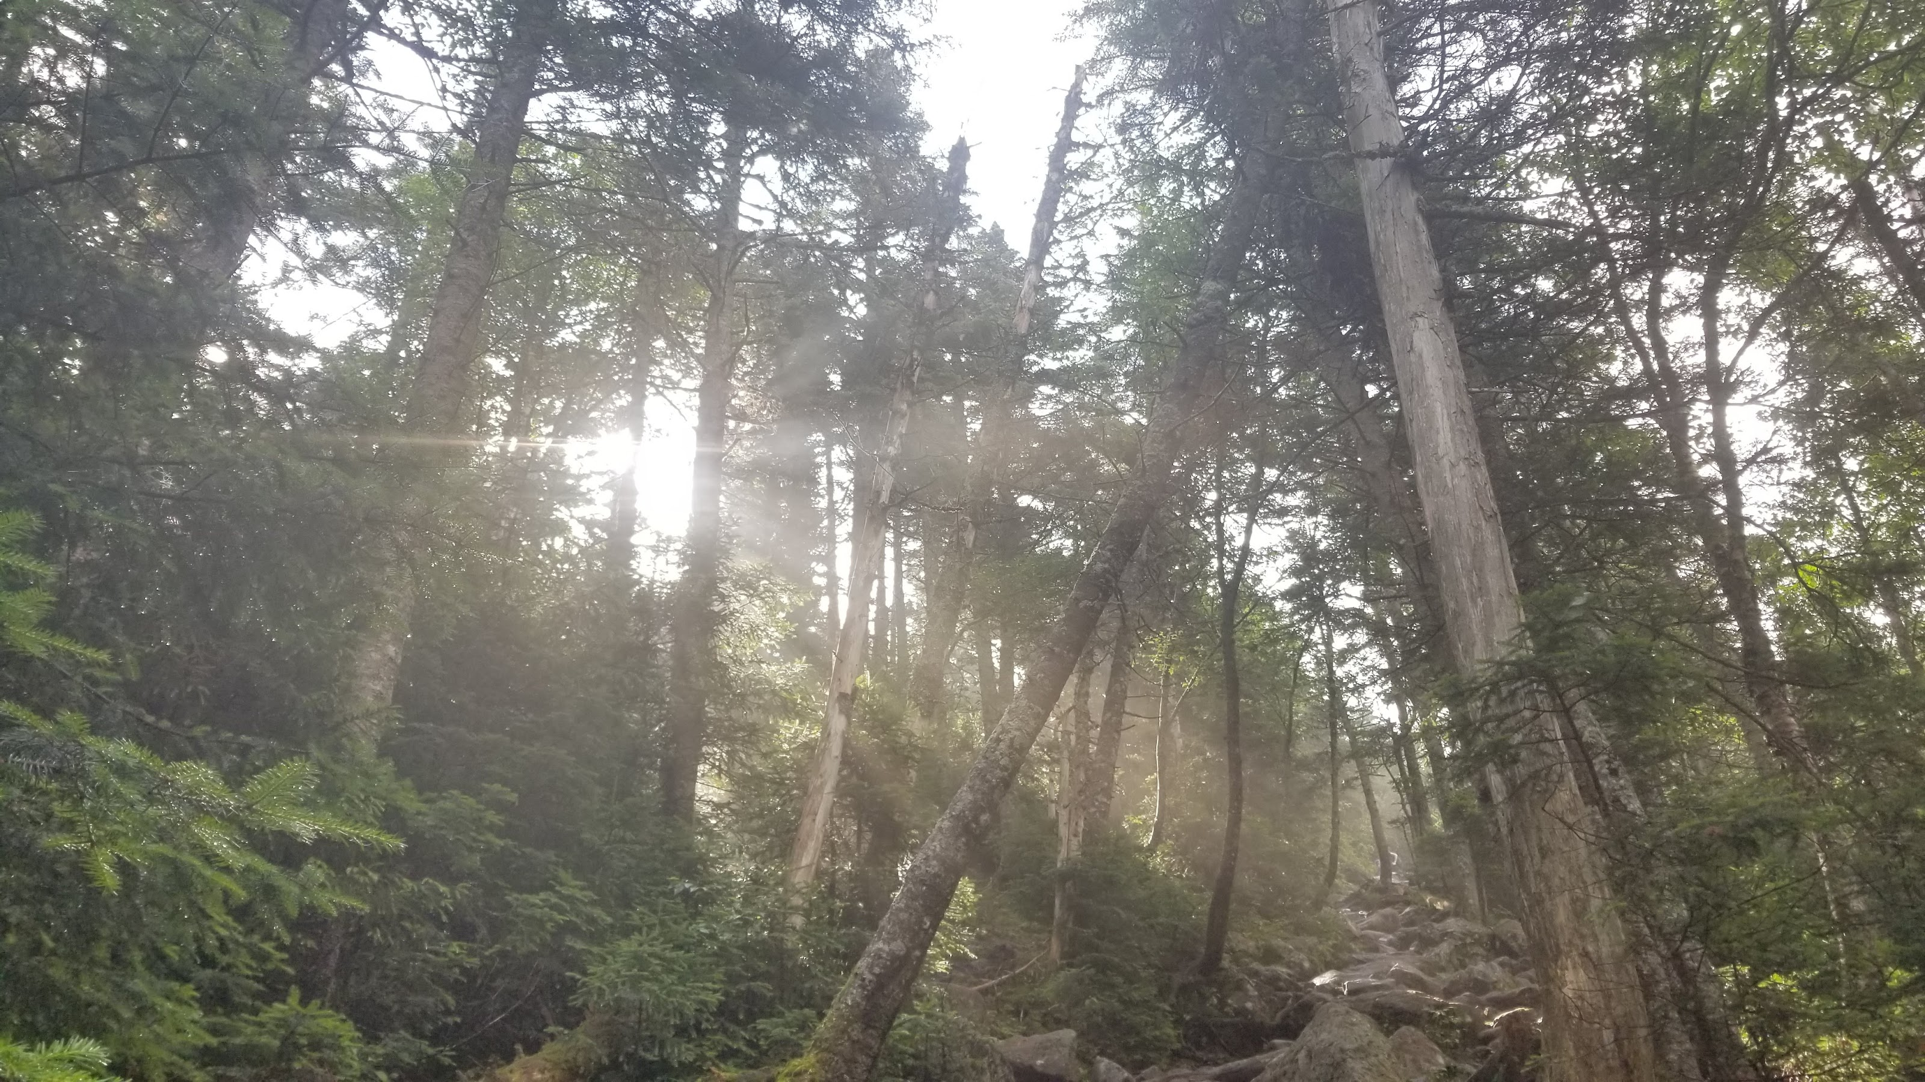
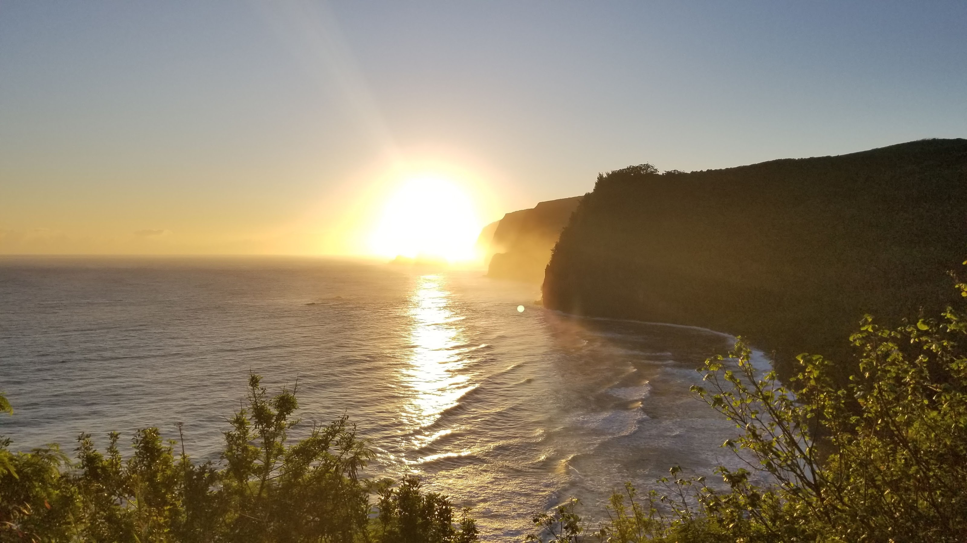
What does the future hold?

